Slide 1
Unit -2:Introducing full-stack development

Slide 2
Contents
The benefits of full-stack development
An overview of the MEAN stack components
What makes the MEAN stack so compelling

Slide 3
Full-stack development and components
All parts of a website or application
Components
MongoDB:the database
Express:the web framework
AngularJS:the front-end framework
Node.js:the web server

Slide 4
Why learn the full stack?
Earlier:
Perl + HTML -> Web developer.
Now: Increased browser support of CSS and JS -> complicated front-end implementations

Slide 5
Helping developers with libraries and frameworks
CodeIgniter for PHP and Ruby on Rails
Dojo and jQuery for front-end JavaScript
Simplification -> full-stack developers
build both the front end + application logic.

Slide 6
MOVING THE APPLICATION CODE FORWARD IN THE STACK
Application logic :server -> front end.
JavaScript frameworks:AngularJS, Backbone, and Ember.

Slide 7
Benefits of full-stack development
Better view of the bigger picture
Appreciation
Team members
End-to-end applications
More skills, services, and capabilities.

Slide 8
Node.js(web server/platform)
Not a web server/language.
HTTP server library

Slide 9
JavaScript: The single language through the stack
Fast, efficient, and scalable
reduce their running costs, even at a large scale
Why? singlethreaded,whereas traditional web servers are multithreaded

Slide 10
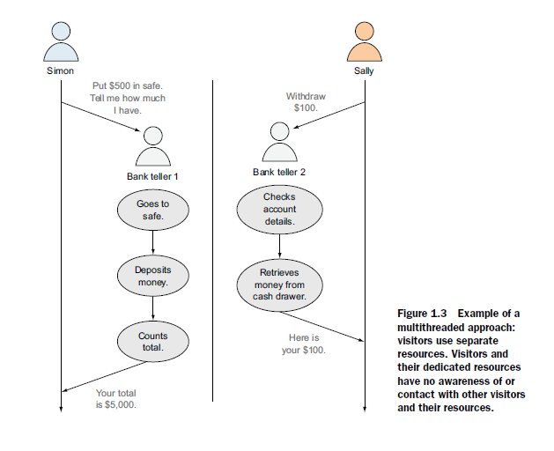
Multithreaded approach

Slide 11
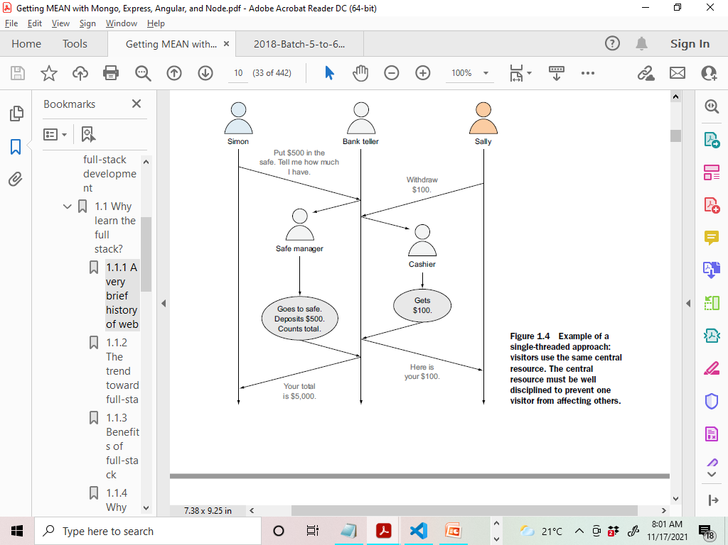
Single Threaded Approach

Slide 12
TRADITIONAL MULTITHREADED WEB SERVER
Multiple bank tellers
So,web servers have so much RAM, even though they don’t need it 90% of the time
A SINGLE-THREADED WEB SERVER
Bank teller -> delegates to back-end staff
Using prebuilt packages via npm

Slide 13
Introducing Express: The framework
designed for Node.js
Set up

Slide 14
Easing your server setup
Node.js is a platform not a server->creative.
Basic website up and running ->Harder.
Express does….
Sets up server -> requests & responses.
Defines a directory structure.
Serve static files in a nonblocking way—CSS file!

Slide 15
Routing URLs to responses
Simple interface for directing an incoming URL -> code
static HTML page,
read from a database,
write to a database.

Slide 16
Views: HTML responses & Remembering visitors with session support
Respond to requests -> sending some HTML to the browser
Express -> easier(native Node.js)
ability to use sessions so that you can identify individual visitors
Multiple requests and pages

Slide 17
Introducing MongoDB: The database
Relational versus document databases
MongoDB documents: JavaScript data store
{
"firstName" : "Simon",
"lastName" : "Holmes",
_id : ObjectId("52279effc62ca8b0c1000007")
}
Support for secondary indexing and rich queries.
What is MongoDB not good for?
Not a transactional db

Slide 18
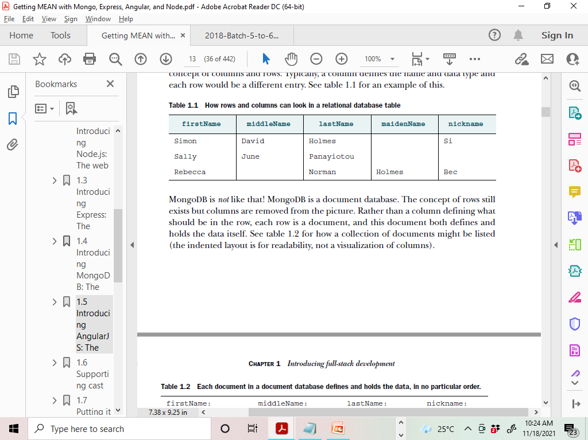
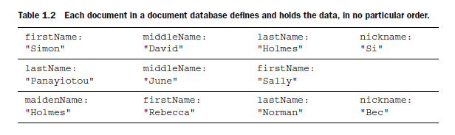
Relational db & Document Db

Slide 19
Mongoose for data modeling
WHAT IS DATA MODELING?
what data can be in a document, and what data must be in a document.
first name, last name, email address, & phone number
connections to MongoDB, save & read data

Slide 20
Introducing AngularJS: The front-end framework
The traditional way : data processing and application
logic on the server-> pass HTML out to the browser.
enables to move some or all of the processing and logic out to the browser
server just passing data from the database.

Slide 21
jQuery versus AngularJS
jQuery :interactivity
after the HTML has been sent to the browser and DOM has completely loaded.
library
AngularJS :step earlier
based on the data provided-> HTML
HTML <->data (update on changes

Slide 22
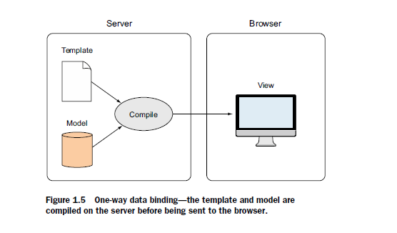
One-way binding

Slide 23
Two-way binding:Working with data in a page
template and data are sent independently to the browser.
The view is bound to the model, so if the model changes the view changes instantly(vice-versa)

Slide 24
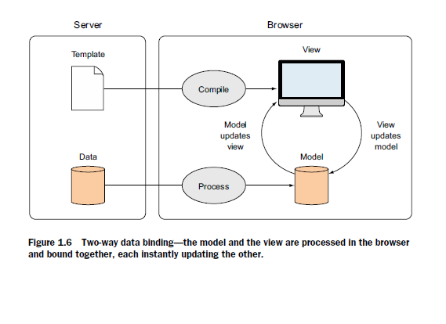
Two-way binding:Working with data in a page

Slide 25
SPA
Application logic, data processing, user flow, and template delivery ->browser managed.
Gmail.
reduce the amount of resources you need on your server
person’s browser is doing the hard work,
server is basically just serving up static files and data on request.
User experience -> better when using this approach.
Once the application loaded -> fewer calls made to the server, reducing the potential of latency.
price ? Why isn't everything built in AngularJS?

Slide 26
Downsides and work around
if browser doesn’t support JavaScript
Search engines

Slide 27
Supporting cast
can use Twitter Bootstrap to help create a good user interface
Git to help manage your code
Heroku to help by hosting the application on a live URL
Twitter Bootstrap for user interface
Twitter Bootstrap to create a responsive design with minimal effort
Uses:responsive grid system, default styles for many interface components, themes.
RESPONSIVE GRID LAYOUT
Bootstrap - 4 different pixel-width for phones, tablets, laptops, and external monitors.
one HTML file - different layouts to the screen size.
CSS CLASSES AND HTML COMPONENTS
Example: page headers, flash-message containers, labels and
badges, stylized lists...

Slide 28
Supporting cast
Twitter bootstrap for user interface
Responsive grid layout
Css classes and html components
Themes
Git for source control
Hosting with heroku

Slide 29
Loc8r
locations of services in nearby places.
(display facilities, opening times, a rating, and a location map for each place)

Slide 30
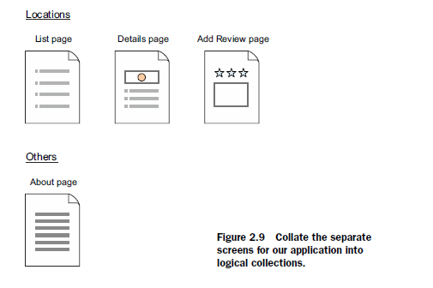
Planning a real application

Slide 31
Loc8r
A screen that lists nearby places
A screen that shows details about an individual place
A screen for adding a review about a place

Slide 32
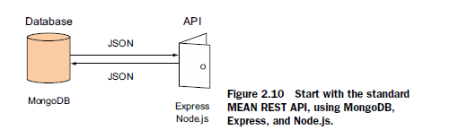
Architecting the application:Starting with the API

Slide 33
REST
A RESTful API is an architectural style for an application program interface (API) that uses HTTP requests to access and use data.
data can be used to GET, PUT, POST and DELETE data types, which refers to the reading, updating, creating and deleting of operations concerning resources.

Slide 34
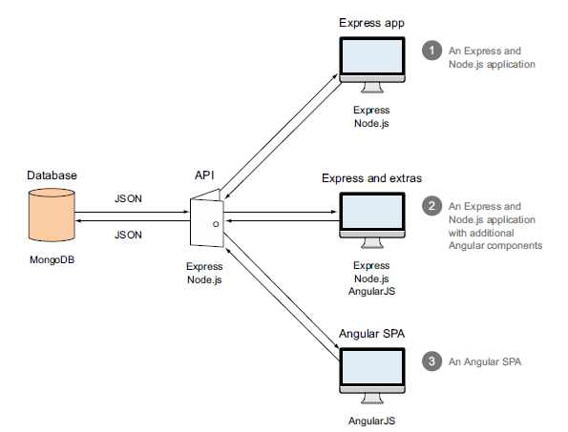
3 options for building Loc8r app

Slide 35
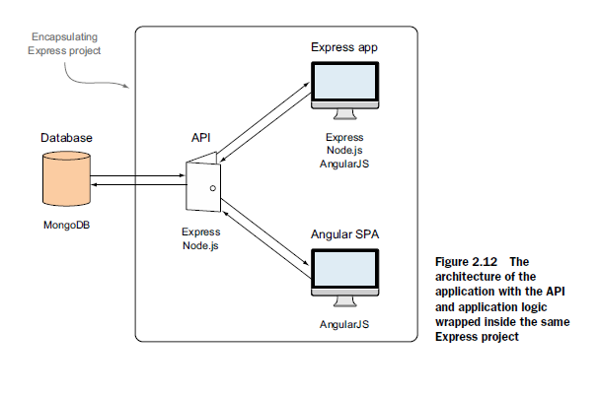
Single Express project

Slide 36
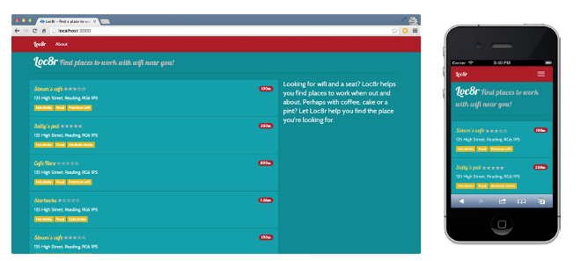
The end product

Slide 37
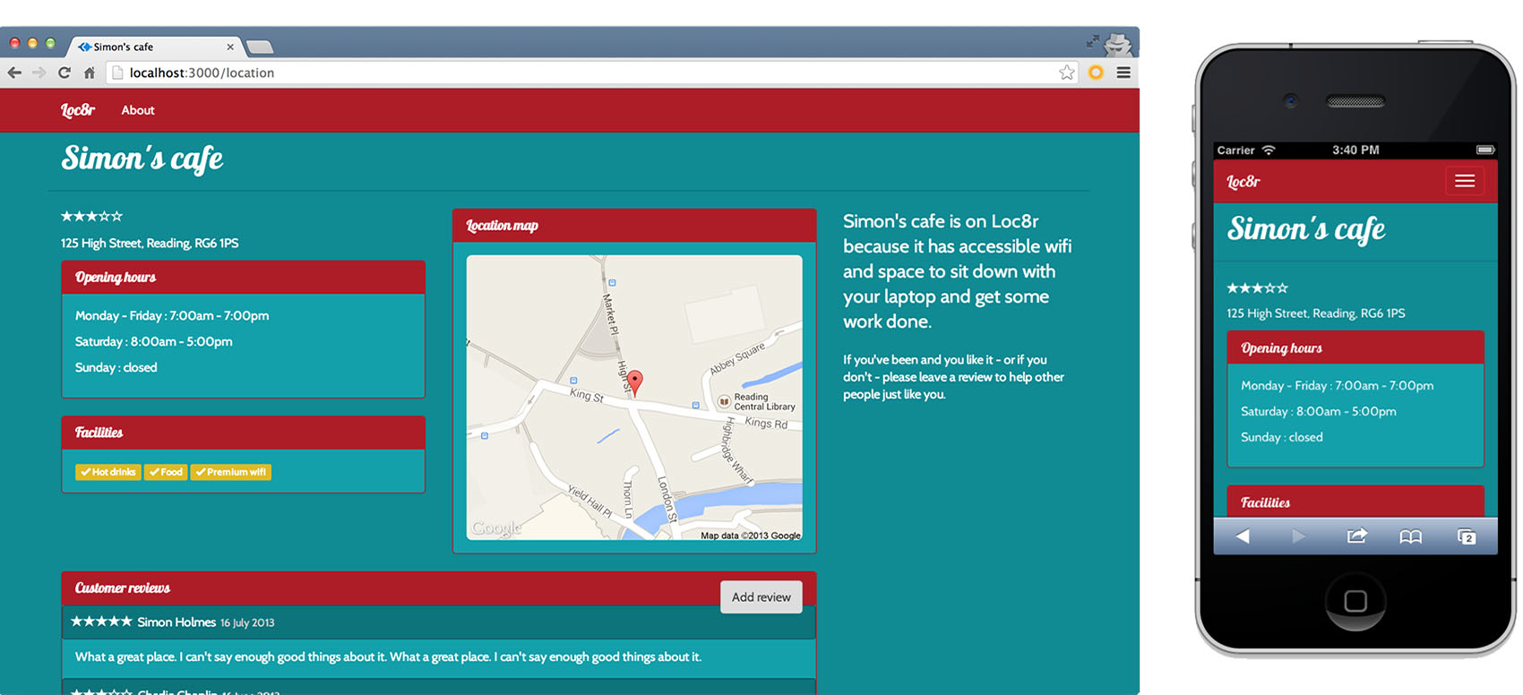

Slide 38
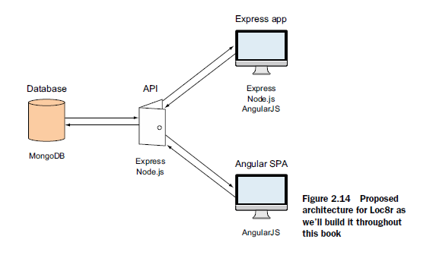

Slide 39
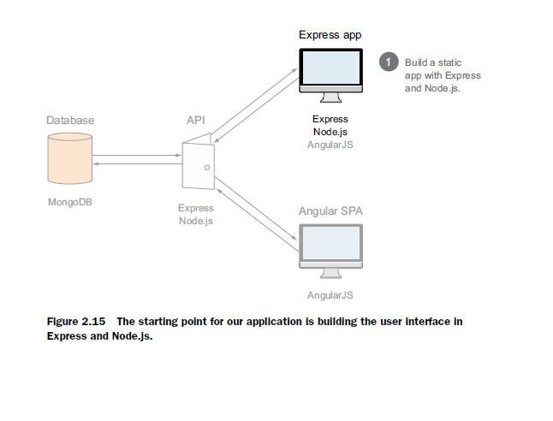
STEP 1: BUILD A STATIC SITE

Slide 40
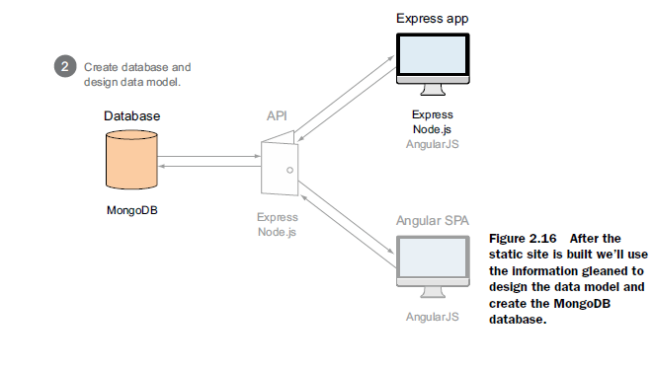
STEP 2: DESIGN THE DATA MODEL AND CREATE THE DATABASE

